Slide 1
Tumor microbiome establishing script
Linh Dang, Areej Shahbaz, Christoph Ammer-Herrmenau

Slide 2

Overview
Basecalling
New basecaller (Dorado), Qscore adjustment
Classification
Different Alignment scores, different coverages
Prevalence filtering
Different cut-offs?
Decontamination
Different approaches
Normalization
Different approaches

Slide 3
Overview
Basecalling
New basecaller (Dorado), Qscore adjustment
Classification
Different Alignment scores, different coverages
Prevalence filtering
Different cut-offs?
Decontamination
Different approaches
Normalization
Different approaches

Slide 4
Basecalling
Guppy High accuracy basecalling
Dorado simplex
Dorado duplex → not yet fully established by ONT → barcoding not possible

Slide 5
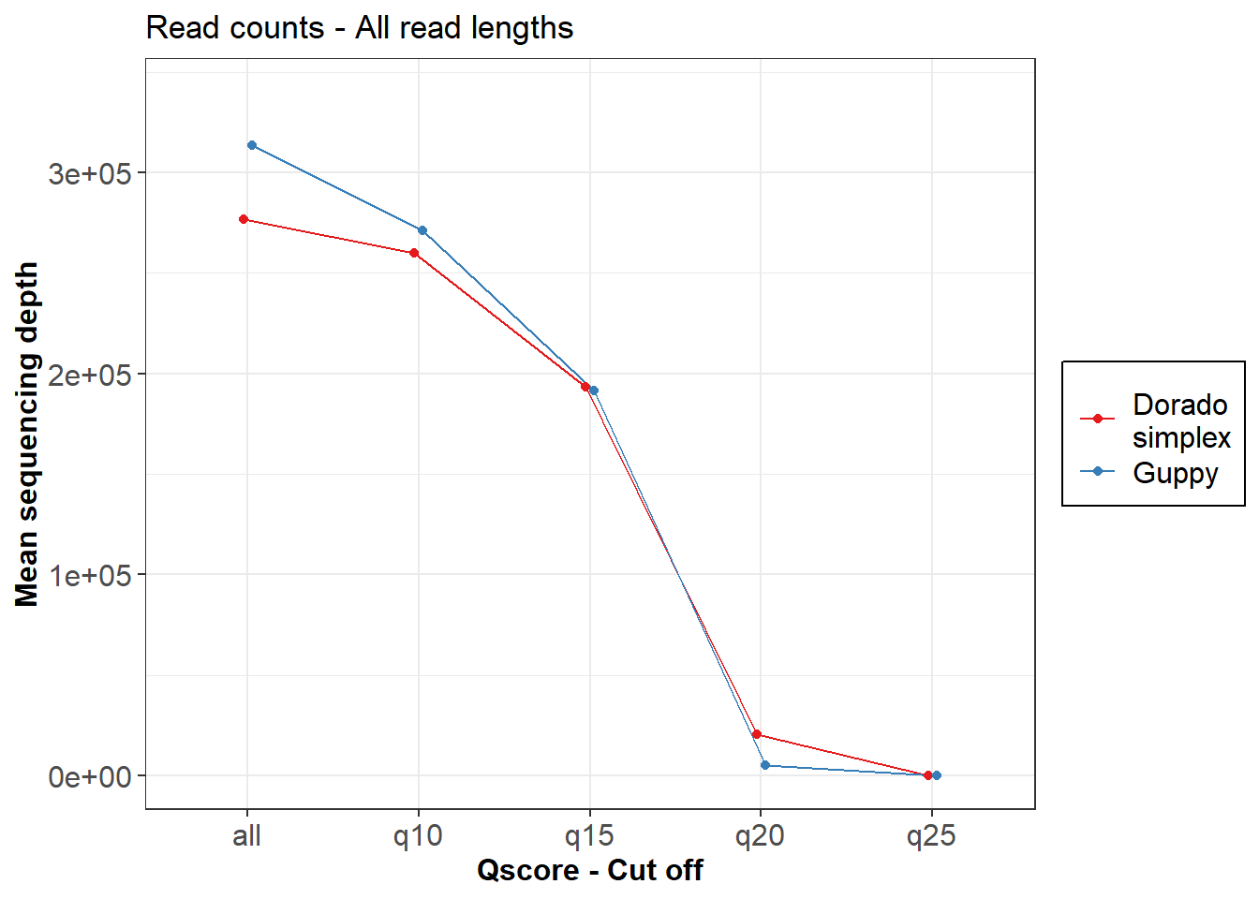
Basecalling – Qscore and read length benchmarking
Guppy High accuracy basecalling
Dorado simplex
More reads with guppy without threshold
With qscore threshold 15 read count same between dorado and guppy
1/3 of reads are lost with qscore 15
Unsatisfactory decline of read counts with qscore of 20

Slide 6
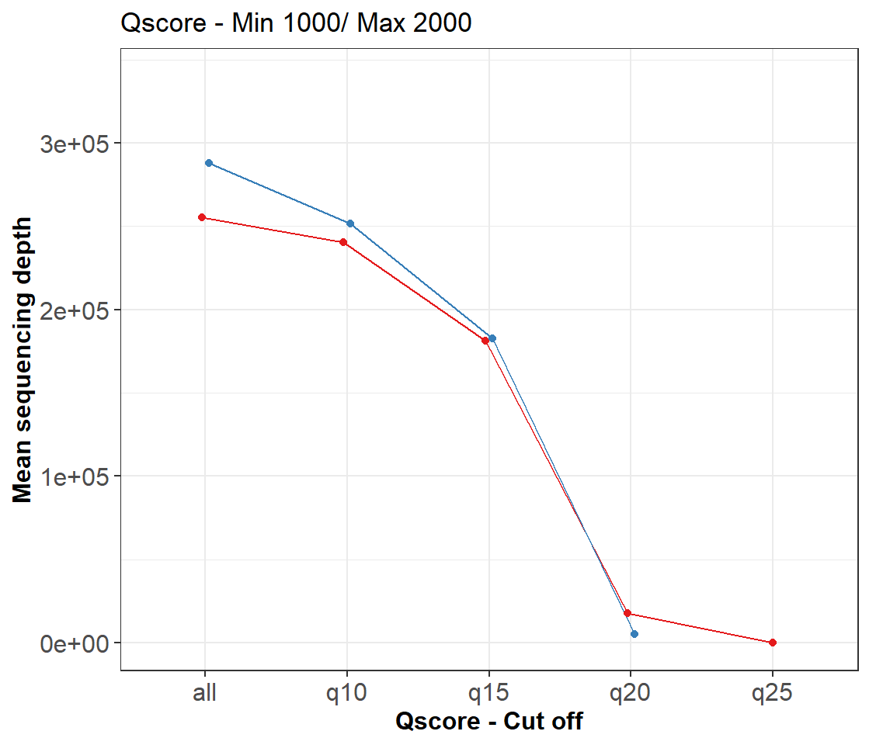
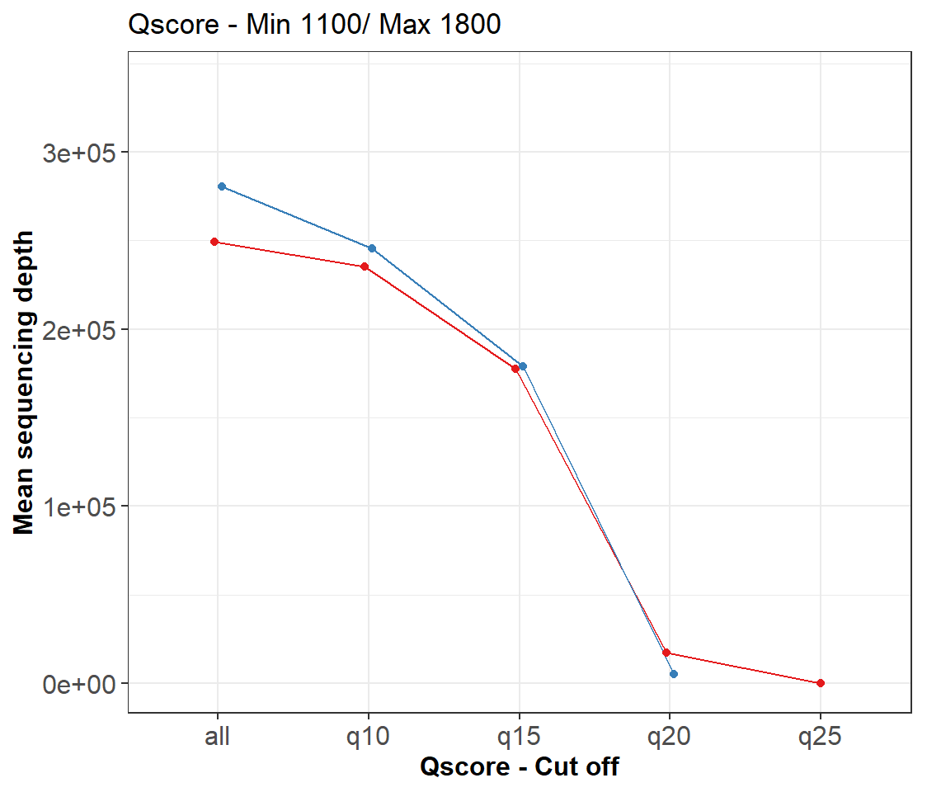
Basecalling – Qscore and read length benchmarking
Guppy High accuracy basecalling
Dorado simplex
Setting minimal and maximal cut- off for read length does not lead in a massive decrease of sequencing depth

Slide 7
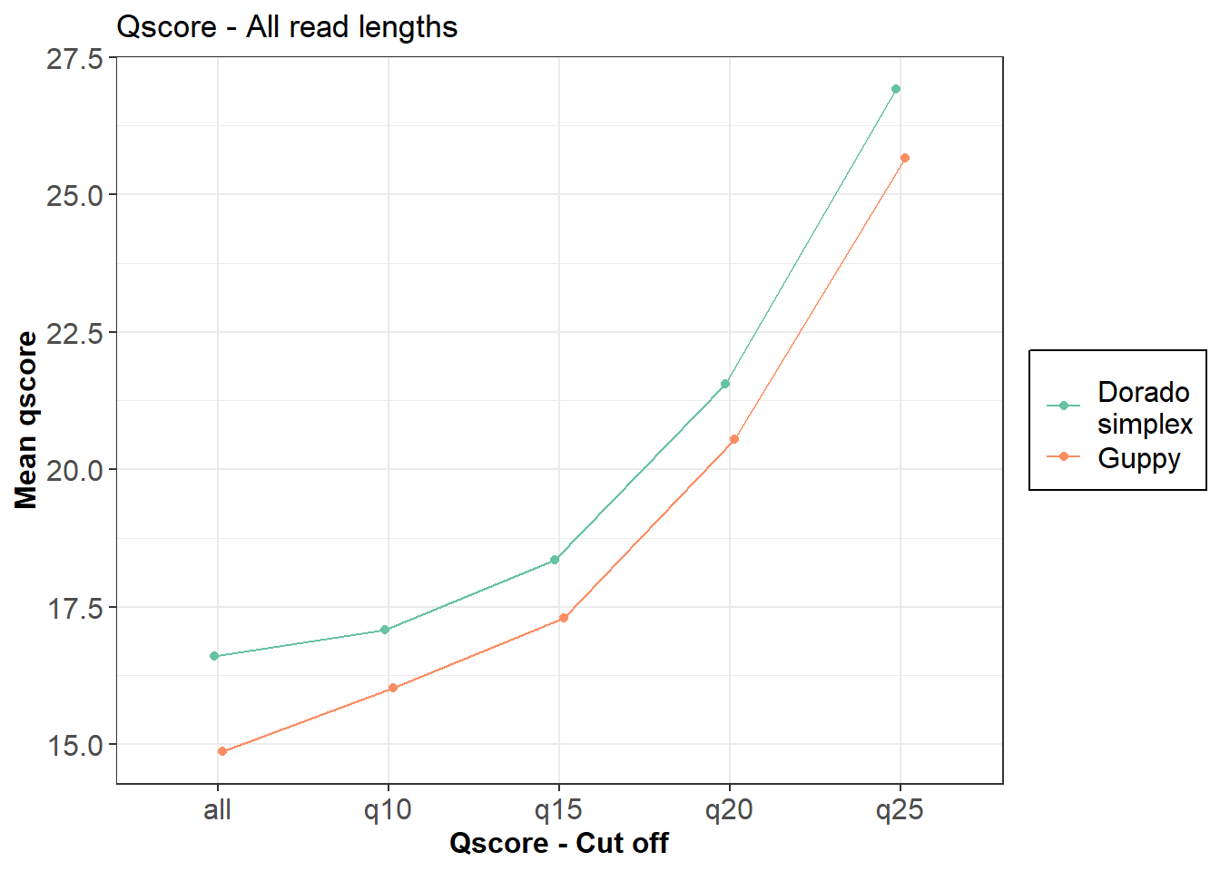
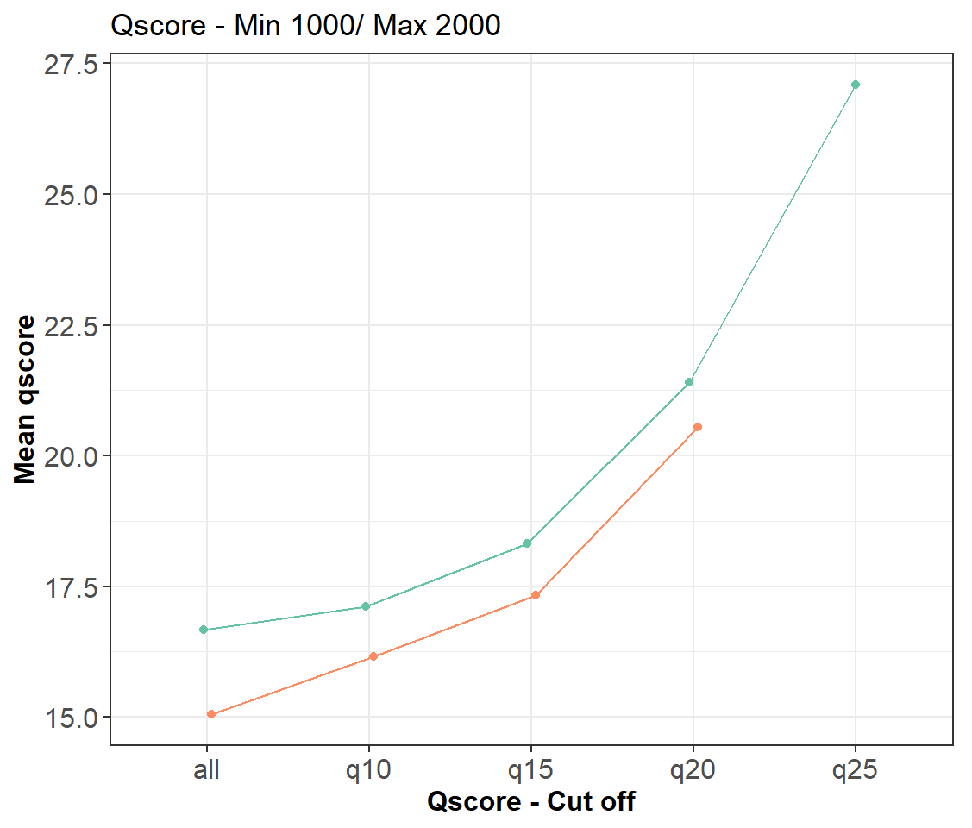
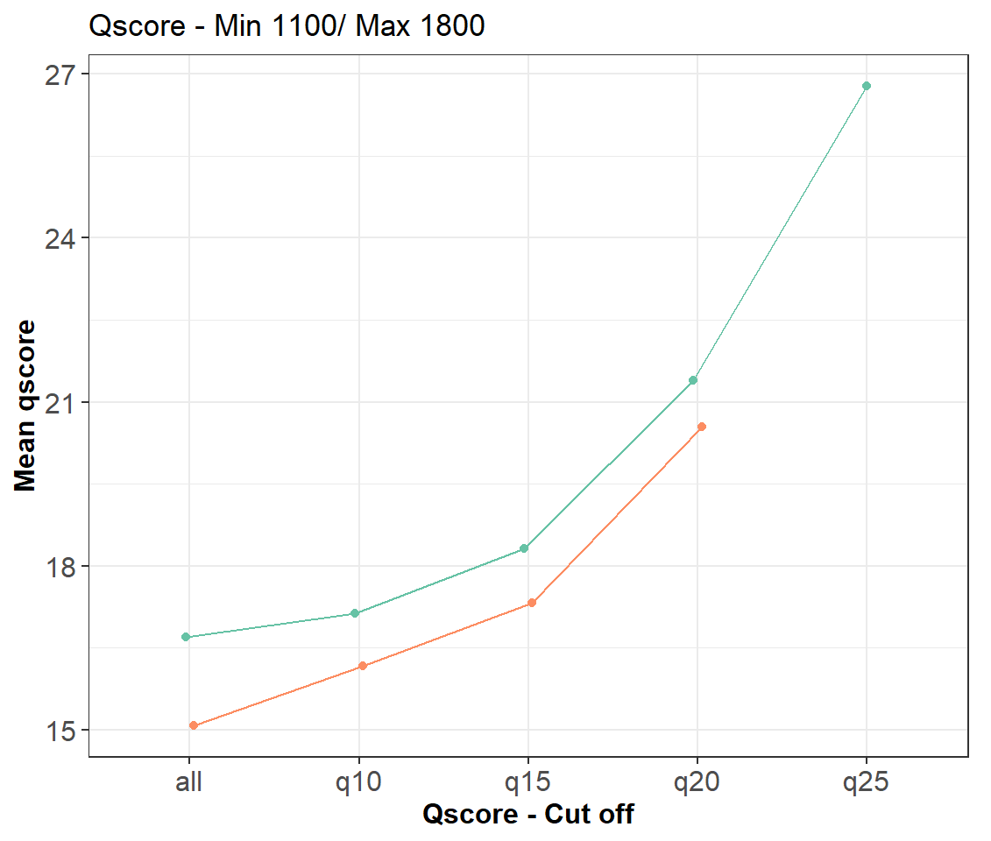
Basecalling – Qscore and read length benchmarking
Guppy High accuracy basecalling
Dorado simplex
Qscore differences of 1 remains regardless set qscore cut-off or read length thresholds.

Slide 8
Basecalling – Qscore and read length benchmarking
Conclusions:
Duplex not yet ready to use
Dorado acquires a higher qscore
Default qscore 15 (loss of 1/3 of reads!)
Read length thresholds do not impact much sequencing count and qscores
Default read length thresholds Min 1100, Max 1800

Slide 9
Overview
Basecalling
New basecaller (Dorado), Qscore adjustment
Classification
Different Alignment scores, different coverages
Prevalence filtering
Different cut-offs?
Decontamination
Different approaches
Normalization
Different approaches

Slide 10
AS Coverage Benchmarking
Qscore 9
Thresholds | n taxID Metapont | n species phyloseq | Proportion high abundant species | high abundance threshold | n reads Metapont | n reads Infoseq Metapont | n reads Phyloseq | mean reads/ sample
AS1000Cov50 | 1522 | 968 | 0,04028926 | 0,02 | 2138115 | 2214099 | 1734681 | 216835,125
AS1000Cov90 | 1393 | 909 | 0,04290429 | 0,02 | 2058170 | 2214099 | 1683260 | 210407,5
AS1000Cov100 | 1286 | 853 | 0,04454865 | 0,02 | 1738126 | 2214099 | 1479702 | 184962,75
AS1500Cov50 | 813 | 478 | 0,06276151 | 0,02 | 1581703 | 2214099 | 1268985 | 158623,125
AS1500Cov90 | 750 | 453 | 0,06622517 | 0,02 | 1524177 | 2214099 | 1234008 | 154251
AS1500Cov100 | 668 | 439 | 0,06833713 | 0,02 | 1271843 | 2214099 | 1175466 | 146933,25
AS1750Cov90 | 441 | 267 | 0,11235955 | 0,02 | 1100688 | 2214099 | 953218 | 119152,25
Qscore 15, Min 1100bp, Max 1800bp
Thresholds | n taxID Metapont | n species phyloseq | Proportion high abundant species | high abundance threshold | n reads Metapont | n reads Infoseq Metapont | n reads Phyloseq | mean reads/ sample
AS1000Cov50 | 1522 | 676 | 0,05769231 | 0,02 | 2138115 | 1421238 | 1220299 | 152537,375
AS1000Cov90 | 1393 | 673 | 0,05794948 | 0,02 | 2058170 | 1421238 | 1210069 | 151258,625
AS1000Cov100 | 1286 | 659 | 0,05918058 | 0,02 | 1738126 | 1421238 | 1083220 | 135402,5
AS1500Cov50 | 813 | 369 | 0,08130081 | 0,02 | 1581703 | 1421238 | 979782 | 122472,75
AS1500Cov90 | 750 | 363 | 0,08264463 | 0,02 | 1524177 | 1421238 | 972850 | 121606,25
AS1500Cov100 | 668 | 351 | 0,08547009 | 0,02 | 1271843 | 1421238 | 921200 | 115150
AS1750Cov90 | 441 | 185 | 0,16216216 | 0,02 | 1100688 | 1421238 | 848836 | 106104,5

Slide 11
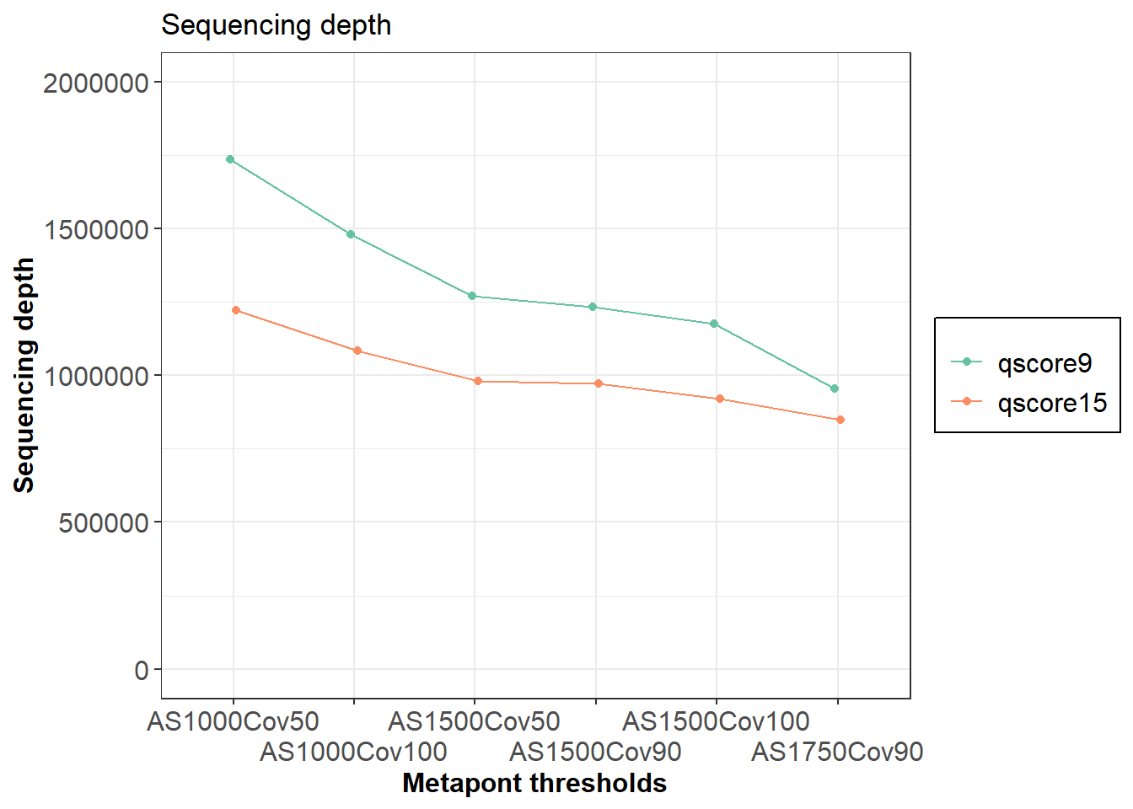
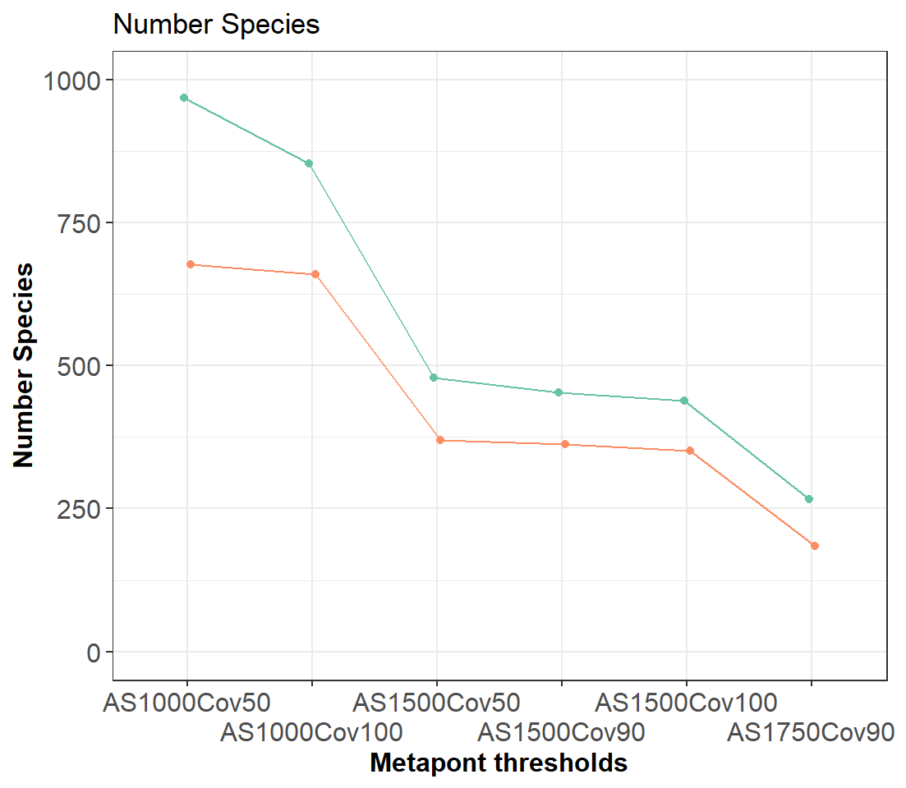
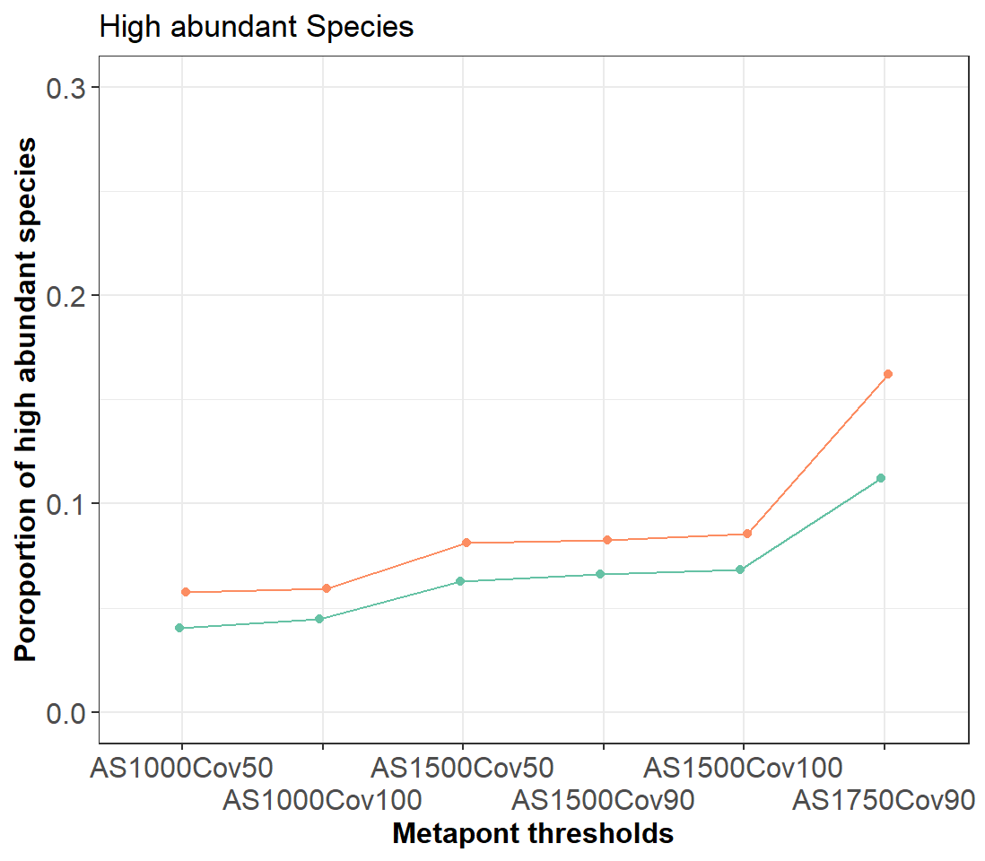
AS Coverage Benchmarking

Slide 12
AS Coverage Benchmarking
Conclusions:
Qscore 9 vs. 15 → ~ 100 species less in phyloseq object (1500_90: 453 vs. 363 species)
Qscore 9 vs. 15 → 30% more high abundant species (1500_90: 0.6 vs. 0.8 species > 2% in at least one sample)
Coverage does significantly affect sequencing depth between 90 and 100 without reducing species count → 90 cov as default
AS is driving factor. Mean read count per samples reduce less dramatic as species count. Therefore, AS should be as high as possible.
With higher AS the sequencing depth does not decrease in this extend as the species count decline → low abundant species rather bioinformatical garbage
AS1750 Cov90 q15 has lowest species count but reasonable sequencing depth → default

Slide 13
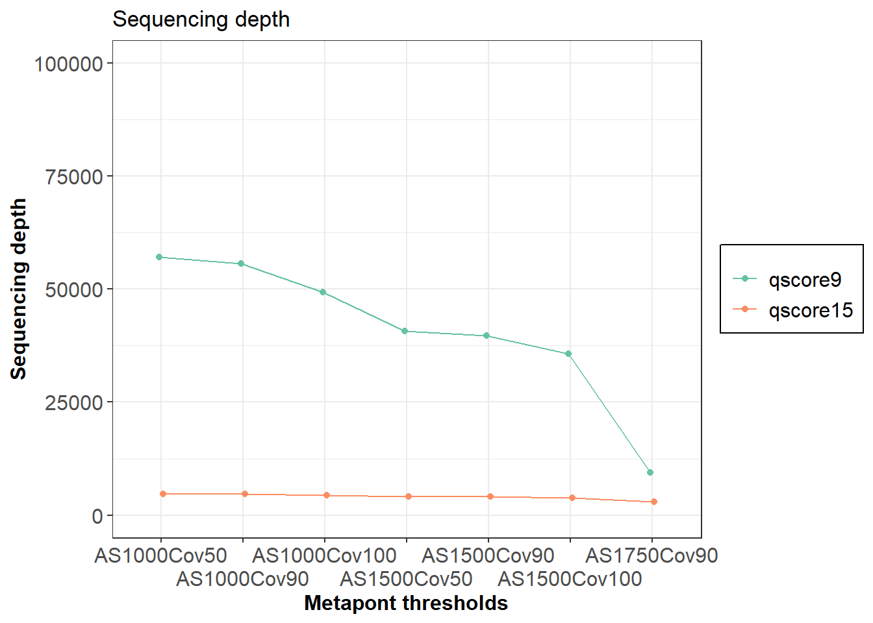
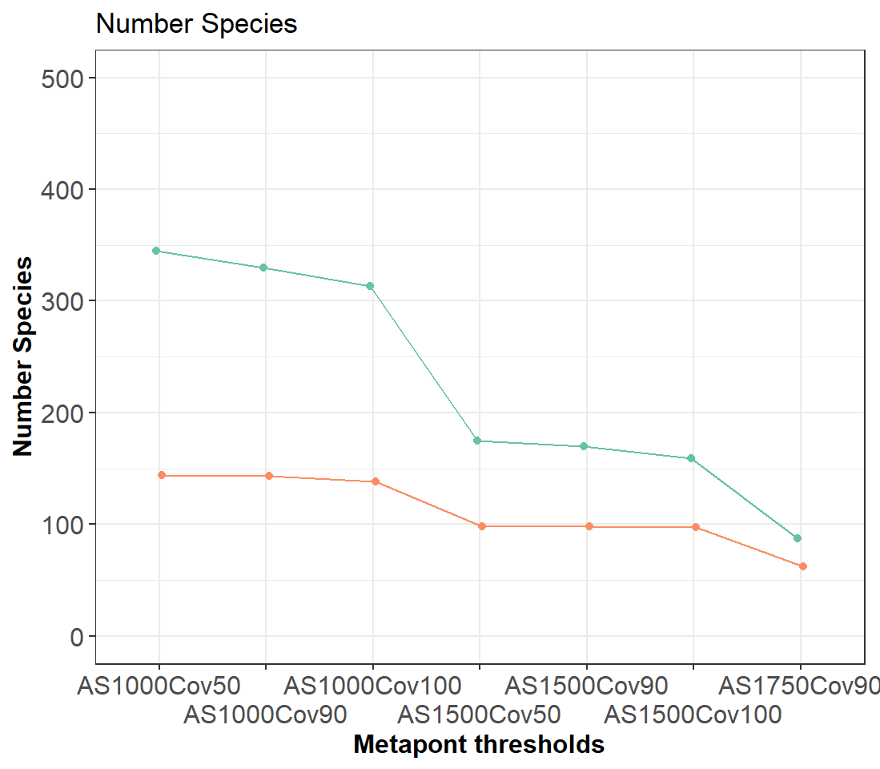
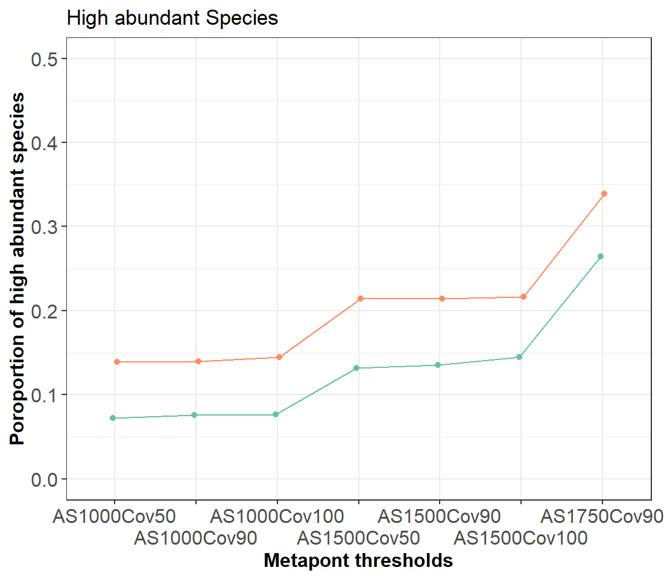
NCT - AS Coverage Benchmarking

Slide 14
NCT - AS Coverage Benchmarking
Conclusions:
Qscore 9 vs. 15 → ~ 200 species less in phyloseq object
Qscore 9 vs. 15 → 30% more high abundant species (1500_90: 1.5 vs. 2.0 species > 2% in at least one sample)
Coverage does significantly affect sequencing depth between 90 and 100 without reducing species count → 90 cov as default
AS is driving factor. Mean read count per samples reduce less dramatic as species count. Therefore, AS should be as high as possible.
With higher AS the sequencing depth does not decrease in this extend as the species count decline → low abundant species rather bioinformatical garbage
AS1750 Cov90 q15 has lowest species count but reasonable sequencing depth → default

Slide 15
Overview
Basecalling
New basecaller (Dorado), Qscore adjustment
Classification
Different Alignment scores, different coverages
Prevalence filtering
Different cut-offs?
Decontamination
Different approaches
Normalization
Different approaches

Slide 16
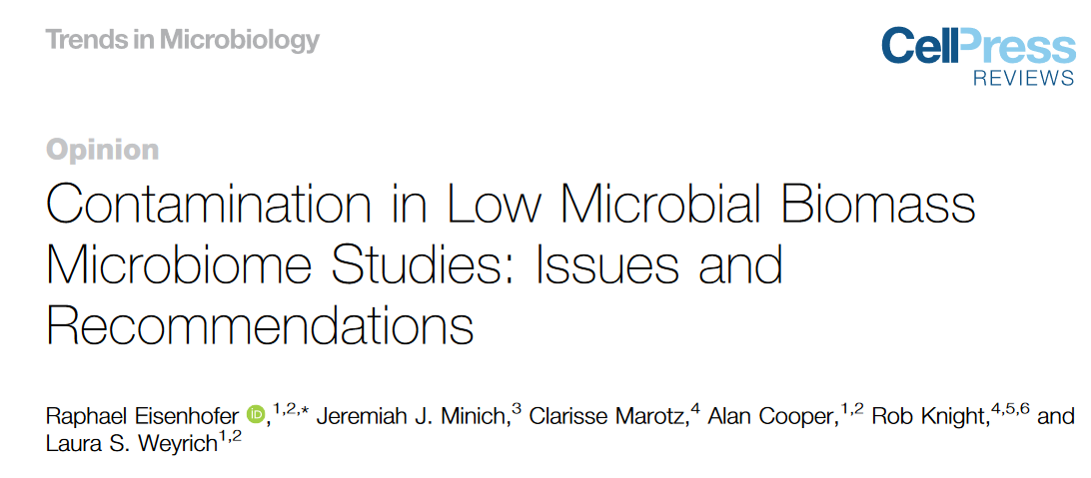
Decontamination overview
Decontam
SCRuB
Nejman
Recentrifuge → classification based
Sqeegee → classification based
Grimer

Slide 17
Questions
Does the Qscore, AS and Cov thresholds affects the decontamination process?
Does more NCTs (8 vs. 4) discriminate better?
Does different decontamination approach define different contaminants?
Does a decontamination process on genus level is even more sufficient?

Slide 18
Answers 1
Does the Qscore, AS and Cov thresholds affects the decontamination process?
Decontamination | Count of TRUE Taxa | Count of COntaminants | Mean read Count | Min read Count | Max read Count
Decontam Low Scores 4xNCT | 97 | 69 | 61708,5 | 29235 | 116994
Decontam Low Scores 8xNCT | 91 | 75 | 61105,25 | 30516 | 117276
Decontam High Scores 4xNCT | 121 | 45 | 48442,5 | 8277 | 116500
SCRuB Low Scores 4xNCT | 93 | 73 | 59518,125 | 27450 | 114924
SCRuB Low Scores 8xNCT | 91 | 75 | 59640,625 | 27446 | 114880
SCRuB High Scores4xNCT | 124 | 42 | 94504,875 | 74777 | 120050
Nejman 4xNCT | 75 | 91 | 30397,625 | 2316 | 92766
Nejman 8xNCT | 68 | 98 | 43605,625 | 2374 | 116141
Low scores means: qscore9, AS1000, Cov50
High scores: qscore15, AS1750, Cov90
With high scores the sequences controls have no reads. Therefore, nejman could not be applied
High scores leads to less taxa in NCTs and consecutively less detected contamination
→ Low score NCT to increase sensitivity of contamination detection

Slide 19
Answers 2
Does more NCTs (8 vs. 4) discriminate better?
Decontamination | Count of TRUE Taxa | Count of COntaminants | Mean read Count | Min read Count | Max read Count
Decontam Low Scores 4xNCT | 97 | 69 | 61708,5 | 29235 | 116994
Decontam Low Scores 8xNCT | 91 | 75 | 61105,25 | 30516 | 117276
Decontam High Scores 4xNCT | 121 | 45 | 48442,5 | 8277 | 116500
SCRuB Low Scores 4xNCT | 93 | 73 | 59518,125 | 27450 | 114924
SCRuB Low Scores 8xNCT | 91 | 75 | 59640,625 | 27446 | 114880
SCRuB High Scores4xNCT | 124 | 42 | 94504,875 | 74777 | 120050
Nejman 4xNCT | 75 | 91 | 30397,625 | 2316 | 92766
Nejman 8xNCT | 68 | 98 | 43605,625 | 2374 | 116141
More NCTs leads to less true taxa and more contaminants
More NCTs are accompanied with higher read counts assuming that more low abundant species were identified
→ As more NCT as better

Slide 20
Answers 3
Does different decontamination approach define different contaminants?
Decontamination | Count of TRUE Taxa | Count of COntaminants | Mean read Count | Min read Count | Max read Count
Decontam Low Scores 4xNCT | 97 | 69 | 61708,5 | 29235 | 116994
Decontam Low Scores 8xNCT | 91 | 75 | 61105,25 | 30516 | 117276
Decontam High Scores 4xNCT | 121 | 45 | 48442,5 | 8277 | 116500
SCRuB Low Scores 4xNCT | 93 | 73 | 59518,125 | 27450 | 114924
SCRuB Low Scores 8xNCT | 91 | 75 | 59640,625 | 27446 | 114880
SCRuB High Scores4xNCT | 124 | 42 | 94504,875 | 74777 | 120050
Nejman 4xNCT | 75 | 91 | 30397,625 | 2316 | 92766
Nejman 8xNCT | 68 | 98 | 43605,625 | 2374 | 116141
Count of defined contaminations are equal in Scrub and Decontam
Scrub defined higher abundant species as contaiminants.
Nejaman defined most species as contaminants leading to a strong decrease of read counts in minimum reads.

Slide 21
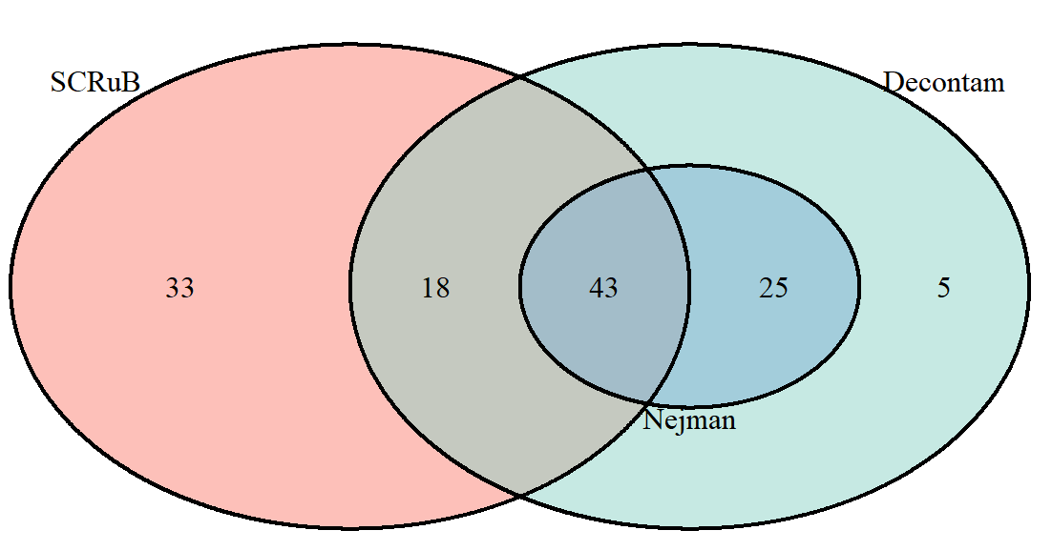
Answers 3
Does different decontamination approach define different contaminants?
Decontamination | Count of TRUE Taxa | Count of COntaminants | Mean read Count | Min read Count | Max read Count
Decontam Low Scores 4xNCT | 97 | 69 | 61708,5 | 29235 | 116994
Decontam Low Scores 8xNCT | 91 | 75 | 61105,25 | 30516 | 117276
Decontam High Scores 4xNCT | 121 | 45 | 48442,5 | 8277 | 116500
SCRuB Low Scores 4xNCT | 93 | 73 | 59518,125 | 27450 | 114924
SCRuB Low Scores 8xNCT | 91 | 75 | 59640,625 | 27446 | 114880
SCRuB High Scores4xNCT | 124 | 42 | 94504,875 | 74777 | 120050
Nejman 4xNCT | 75 | 91 | 30397,625 | 2316 | 92766
Nejman 8xNCT | 68 | 98 | 43605,625 | 2374 | 116141

Slide 22
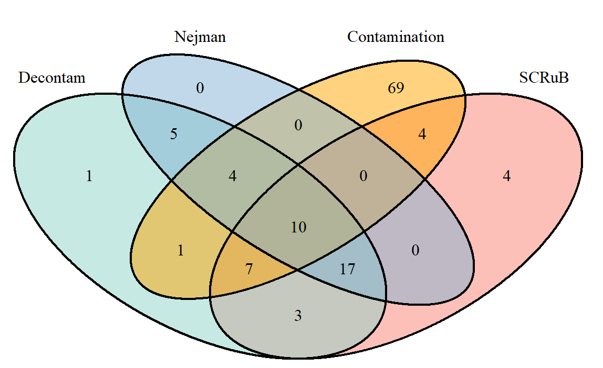
Answers 3
Does different decontamination approach define different contaminants?
Approach | Overlap [%]
Decontam | 45,83
SCRuB | 46,81
Nejman | 38,89
Despite high overlap a lot of taxa can be both: environmental bacs or human commensals. Please refer to detailed genera list.

Slide 23
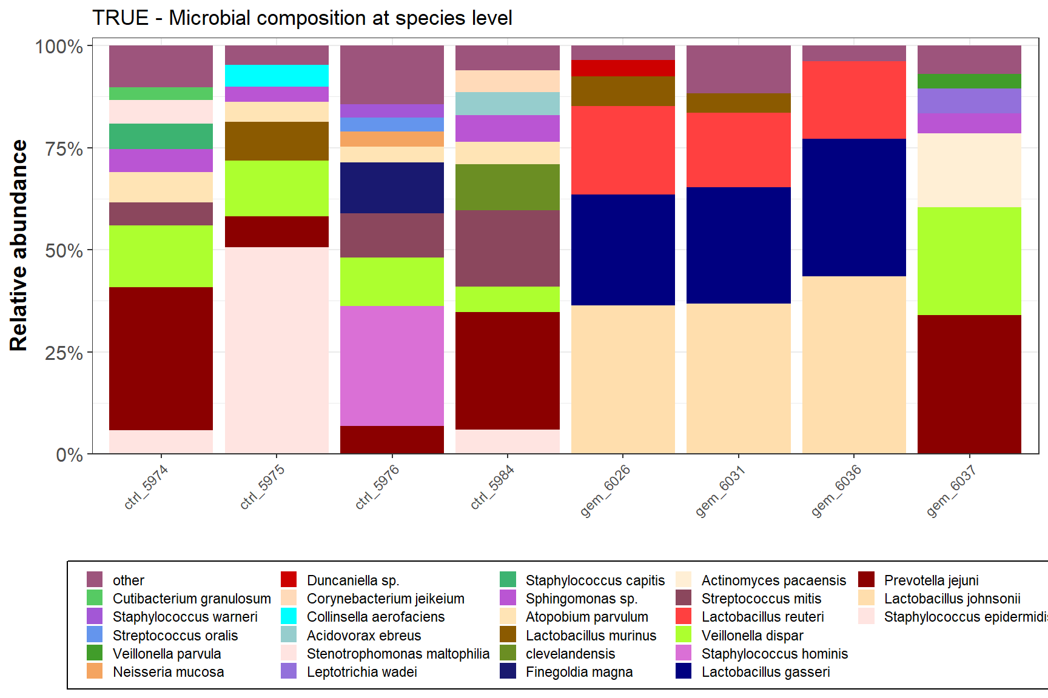
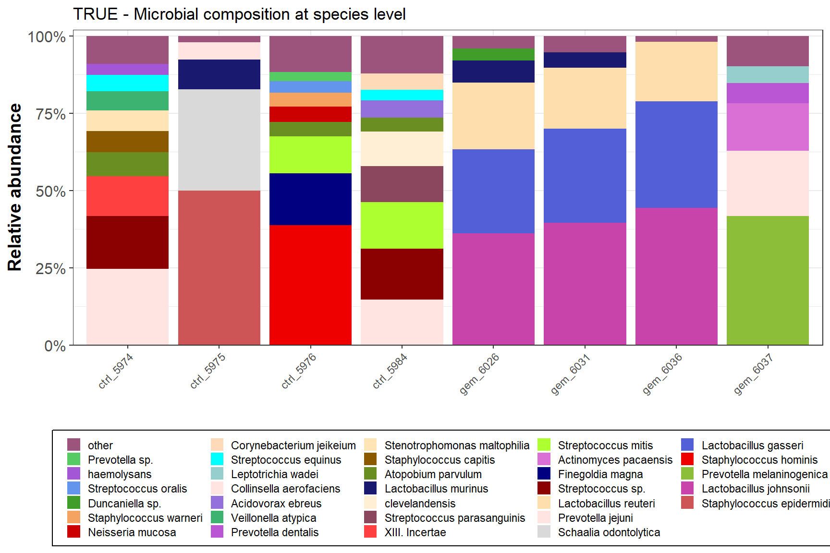
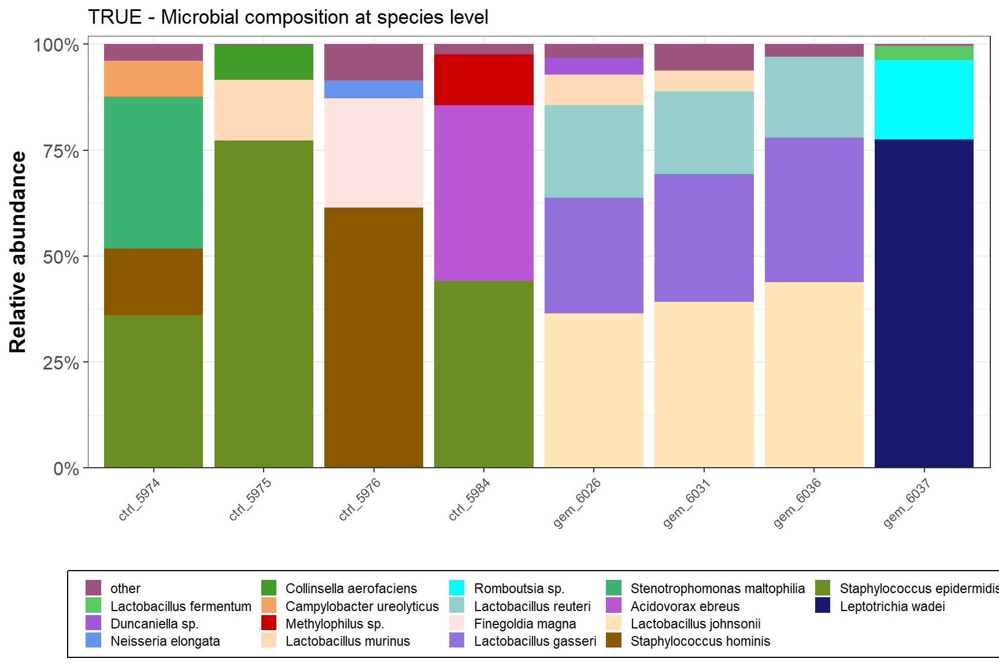
Answers 3
Does different decontamination approach define different contaminants?

Slide 24
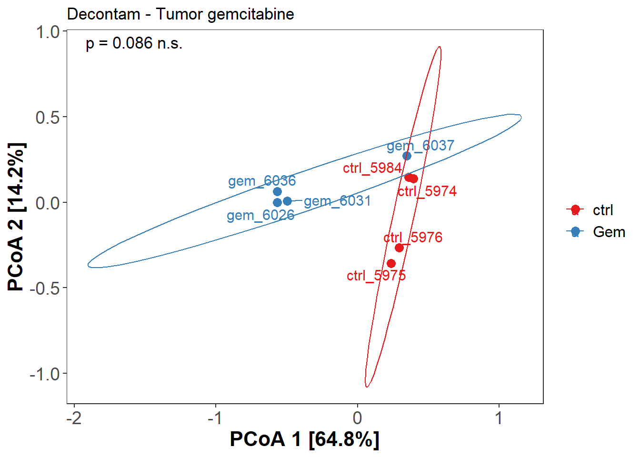
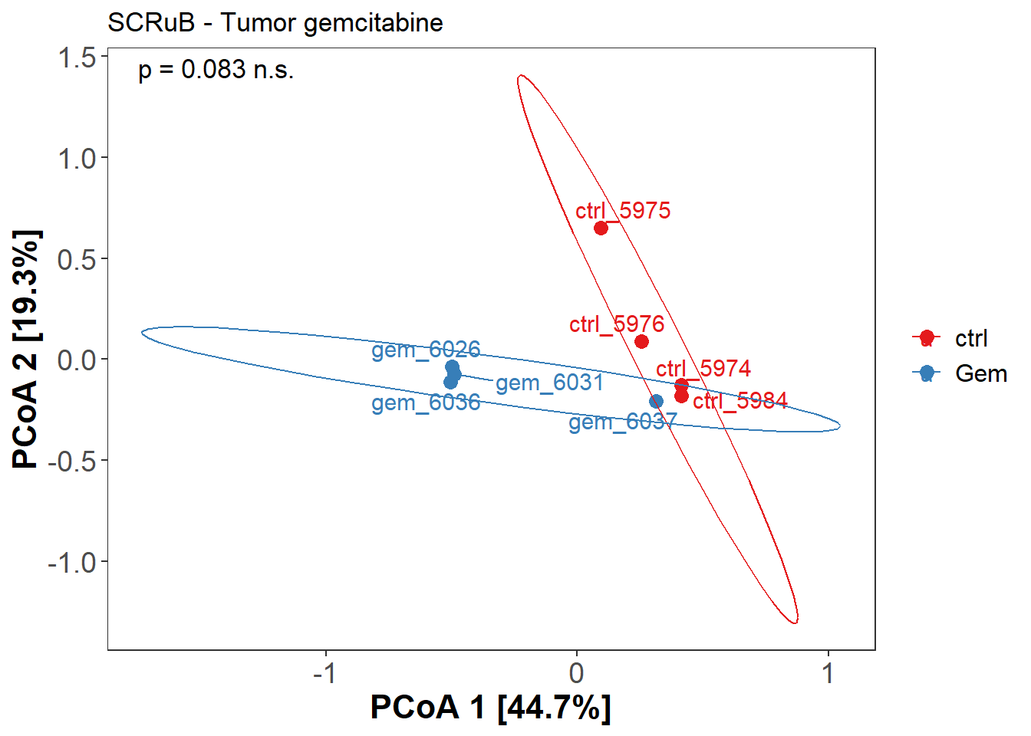
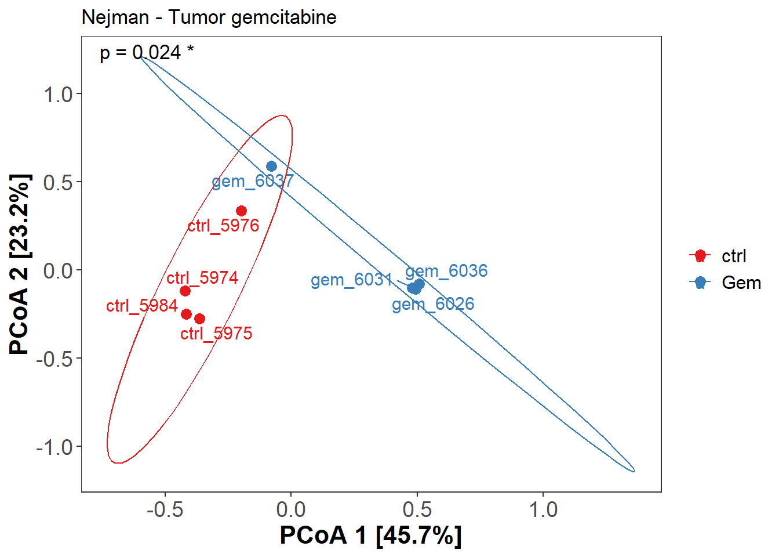
Answers 3
Does different decontamination approach define different contaminants?

Slide 25
How to proceed?
Assessing high prevalent contaminating species based on 200 NCT
Low biomass samples like tumor. What decontamination process is the most suitable?
How many NCT are needed? 8vs.4, 200 vs. 4
How to address the cross-contamintaion (bioinformatics)
In line with RIDE guidelines
3-4 Datasets: 1. Mock community, Gemcitabine, acid treated, (FFPE vs. bulk tissue) → 1750AS 90 Cov
Alpha Diversity, Beta diversity, Differential abundances
Overlap with contamiinations (published and self-determined)
3 Decontamination approaches: Decontam, SCRuB, Nejman → NCTs from DNA extraction, PCR, sequencing
3 Normalization approaches: Rarifiying, wrench normailzation, ALDEX

Slide 26
Assessing high prevalent contaminating species based on 200 NCT
Batch effects on taxa prevalence and abundance
Prevalence of known contaminants taxa over time
Same batch NCTs vs random NCTs on decontamination process
Are NCTs very unique upon batchs, or they have some overlap features specific with the lab
Does every sequencing run need its own NCTs? Assume contaminants mostly from environment and lab/technician, thus one can reuse NCTs from other seq runs??
3 contaminants taxa whose prevalence is highest

Slide 27
Low biomass samples like tumor. What decontamination process is the most suitable?
Metrics for Assessment
Rarefy
Original
Alpha analysis
Wrench
Decontam
Beta Analysis
Srub
ALDEX
Compositional Analysis
Nejman
Subtract
Differential Analysis
(Taxa/functions level)

